Slide 1

Mobile-first, cloud-first world
Notes:
All of us here live in the mobile-first, cloud-first world­ full of technology and information.

Slide 2
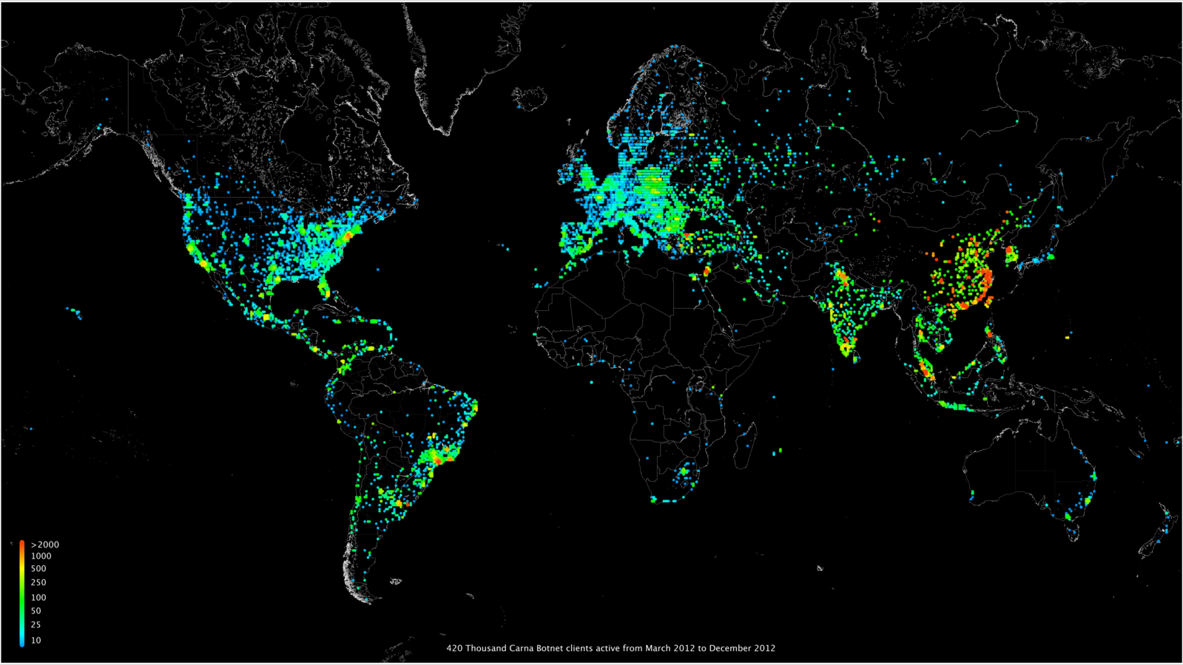
Notes:
However, majority of the world’s population still does not have any Internet access, what makes them unable to leverage the tremendous potential of the results of our work at Microsoft.

Slide 3
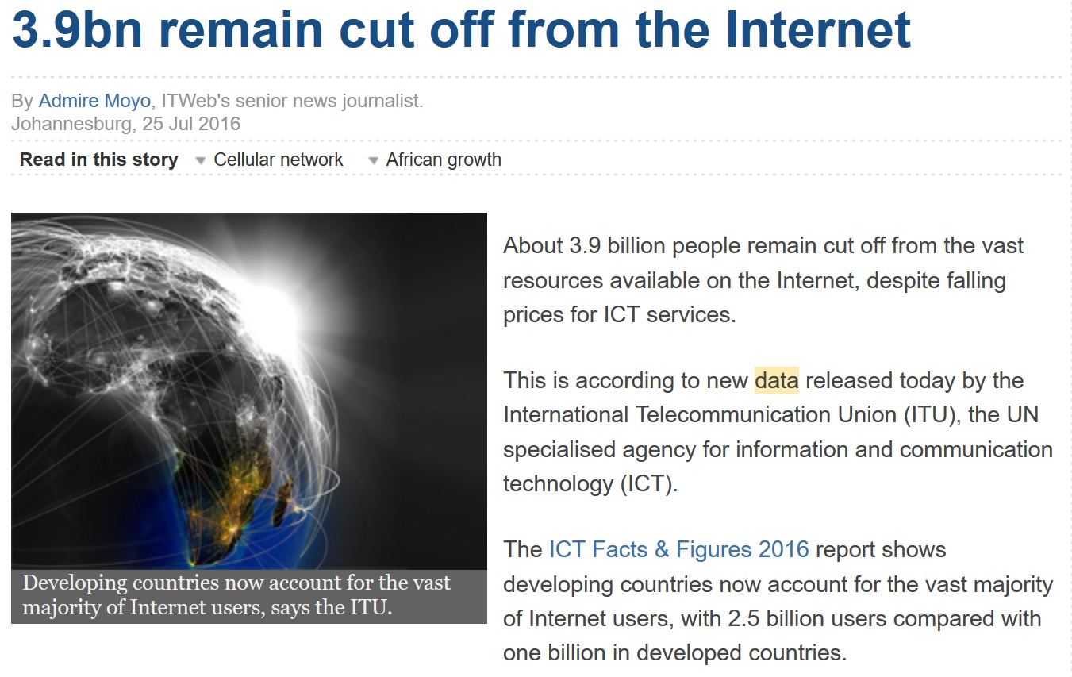
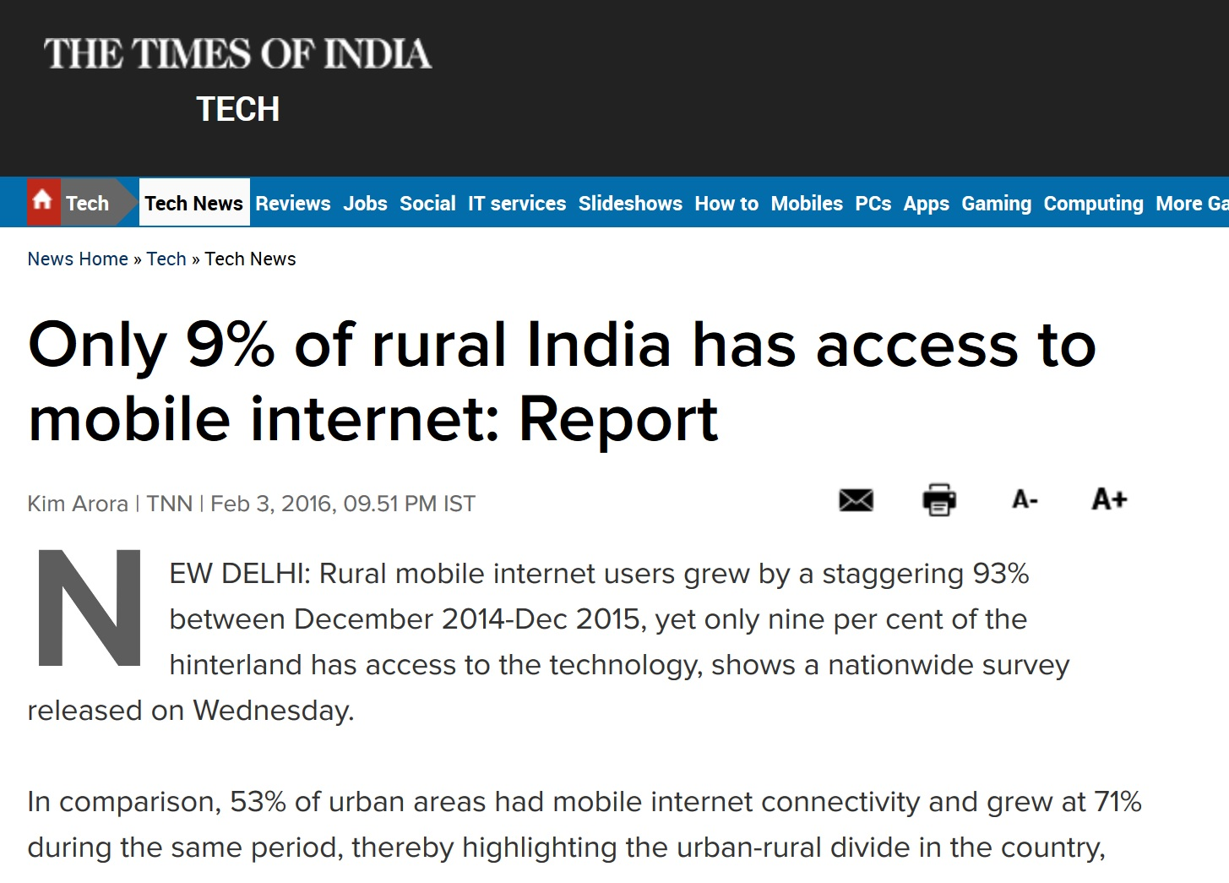
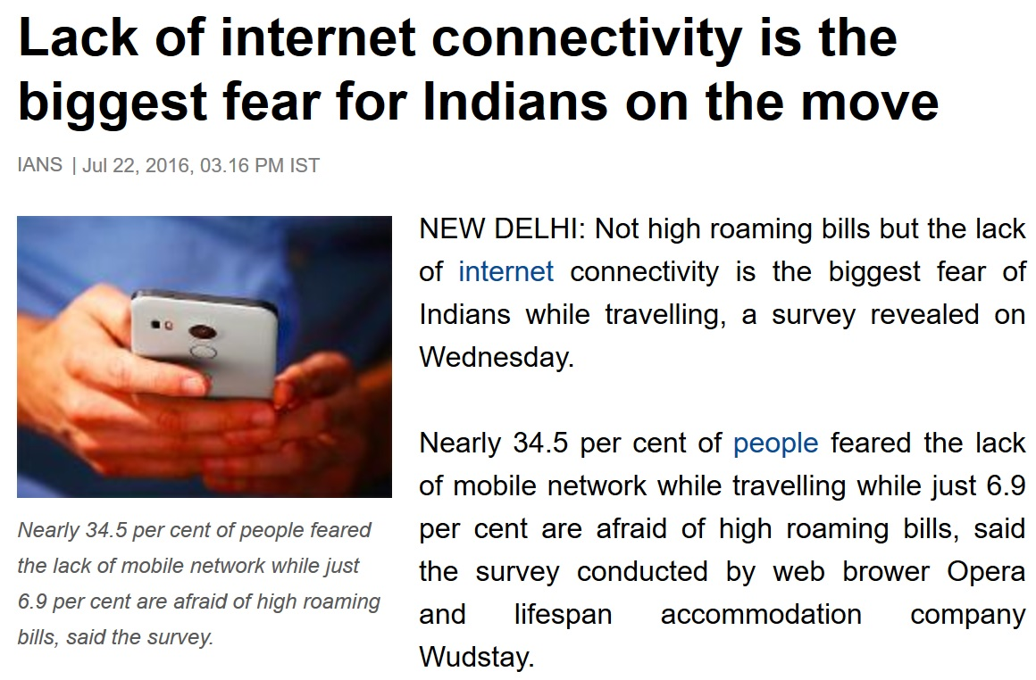
Notes:
There are almost 4 billion such people.

Slide 4

Notes:
Only half a year ago, in rural India, for every 10 people, 9 were completely disconnected from the Internet.

Slide 5

Meet Jasmit
Notes:
Meet one of them – Jasmit. She’s a junior high school student in an Indian village. Despite her curiosity and desire for knowledge, she’s not able to realize her full potential.

Slide 6
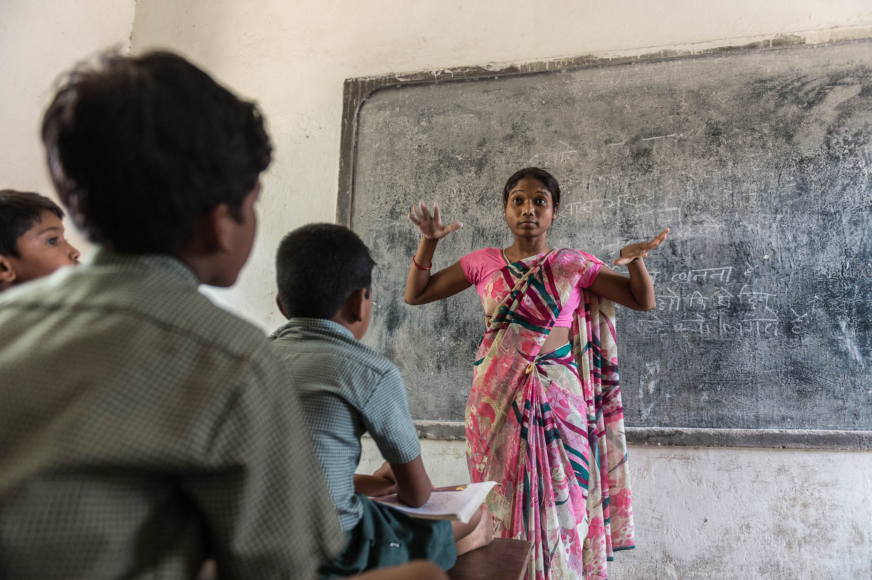
Jasmit’s homework: Women leadership in India
– what did Mother Teresa
do for the society?
Notes:
In a classroom she can’t get answers to her inquisitive questions.

Slide 7
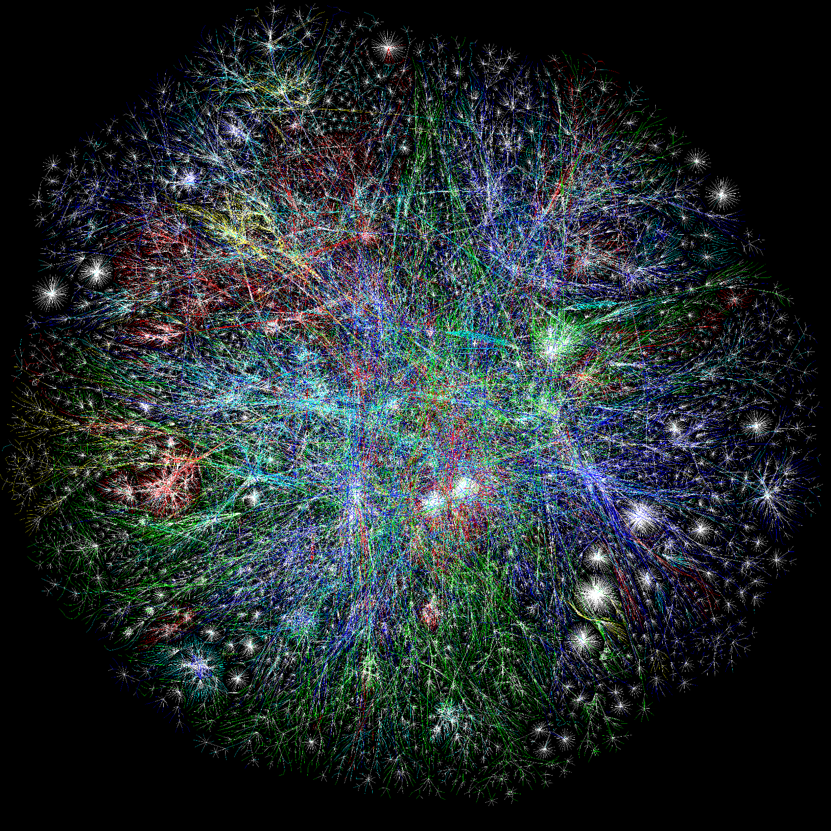

Notes:
Neither can she get them from the Internet.

Slide 8

Notes:
It is our product, which enables her to achieve more.

Slide 9
Call the Web
The whole Internet through calls or texts, no data required
Notes:
Just by using her landline telephone or texting from a mobile she is able to query the web to find the answers for here questions.

Slide 10

Bing Search
Bing maps
Yelp
IBM Watson
Bing translate
Google Search
Wolfram Alpha
…
Notes:
Our cloud service uses machine learning algorithms to retrieve essential pieces of information from the Internet.

Slide 11
“How old are the Egyptian pyramids?” 4585 years.
Notes:
DEMO

Slide 12
“How old are the Egyptian pyramids?” 4585 years.
“Translate ‘I want to make an impact’ to German.”
Ich will etwas bewirken.
Notes:
DEMO

Slide 13
“How old are the Egyptian pyramids?” 4585 years.
“Translate ‘I want to make an impact’ to German.”
Ich will etwas bewirken.
“How to get from Mumbai to New Delhi by car?”
Some answer here.
Notes:
DEMO

Slide 14
Affected people
Residents of developing countries or rural areas
Travelers
Seniors
Disabled people (sight or movement impairments)
Anyone without an Internet access
Notes:
But remember, Jasmit is just one of 4 billion disconnected people. We help residents of developing countries to gain access to knowledge. Travelers to find a train station. Seniors to interact with technology. Disabled people to break their limits.

Slide 15
Call the Web empowers every person on the planet to achieve more
Notes:
Through “Call the Web” we are empowering every person on the planet to achieve more.

Slide 16

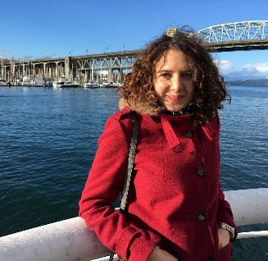
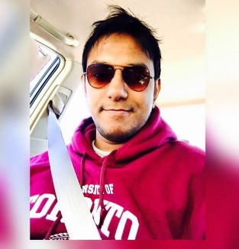
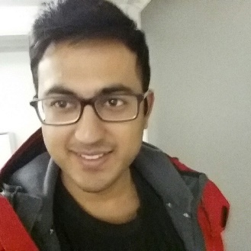
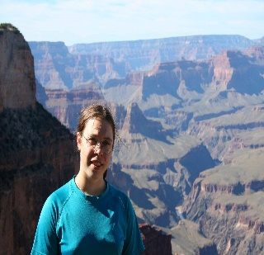
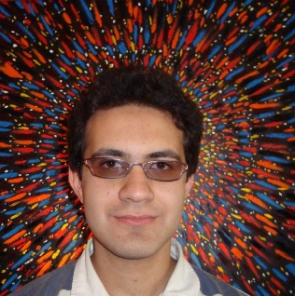
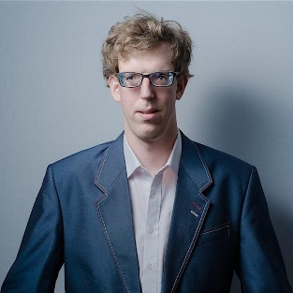
The team
Piotr Mekal
Çiğdem Koçberber
Zohaib Alam
Newton Jain
Magda Bojarska
Amir Bakhtiari
Mike Budd
Microsoft
Notes:
By “we” we mean a group of engineers from Vancouver, BC and the whole Microsoft organization.

Slide 17
Call the Web 587 803 3755
How many bones are there in a human body?
Who is the Canadian prime minister
What is the Canada’s population?
How old Egyptian pyramids are?
What does impairment mean?
What is Mt Everest’s height?
When was Ghandi born? What is 18 times 25?
Who is Bill Gates?
Translate “I love you” to French.
What’s a “grocery store” in Polish?
Please translate “I am looking for a hotel” to Russian.
How do you say “Where is the train station” in Japanese?
Notes:
Now, it’s your time to reach for the phone!

